Slide 1
Patient Health Platform
Group Members:
Maheen Gul 2017-Arid-3420
Usama Qadeer 2017-Arid-3549
Noman Akhtar 2017-Arid-3465
Osama Waseem 2017-Arid-3708
Muhammad Usman 2017-Arid-3477

Slide 2
WEB BASED GUI
Presents By :
Osama Waseem
IT-8B
Group 3
2017-Arid-3708

Slide 3
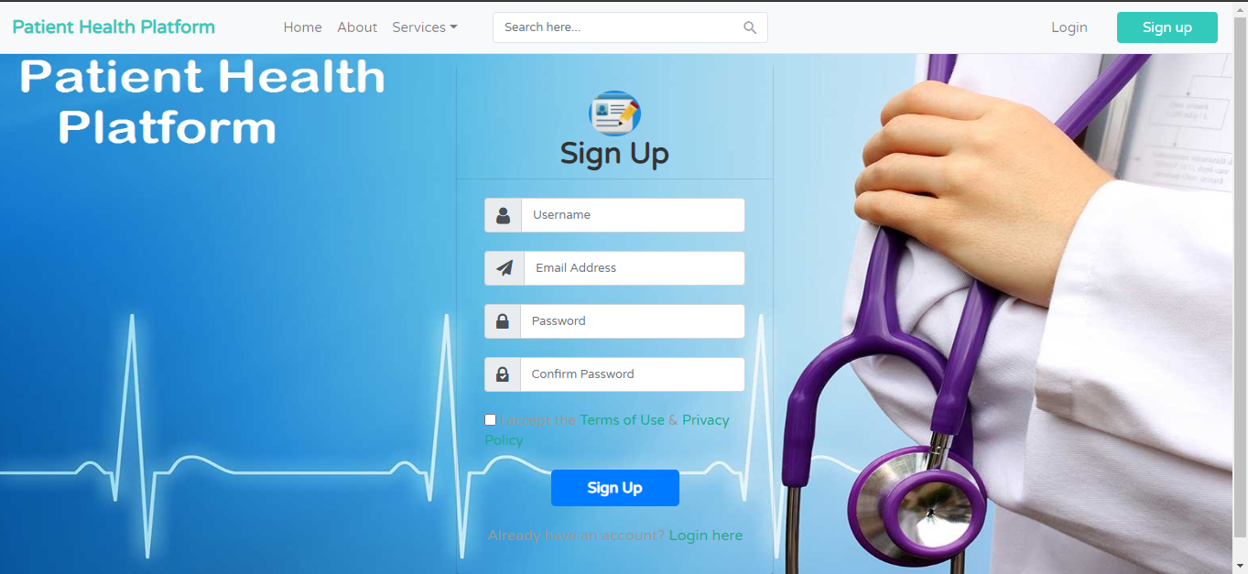
User Sign Up

Slide 4
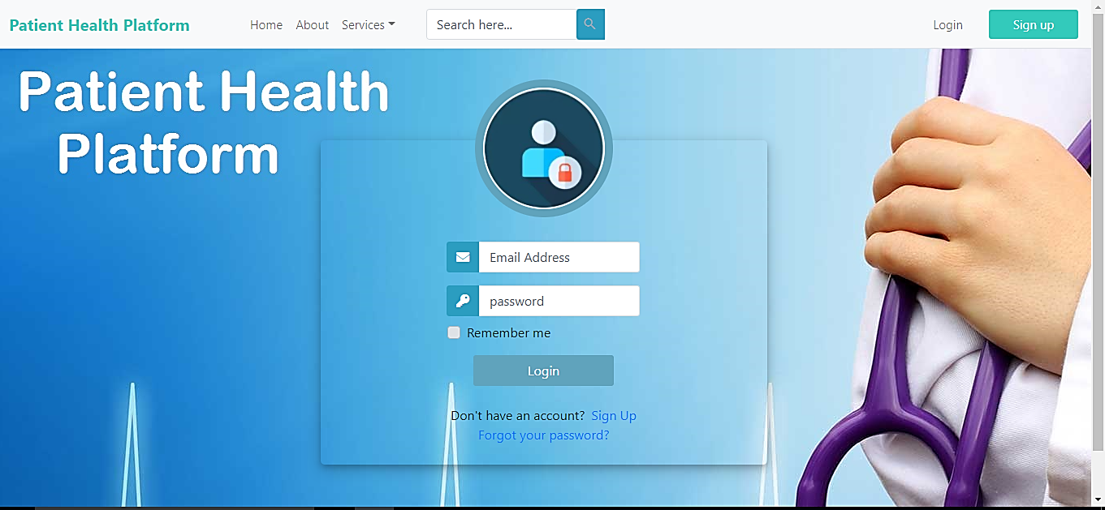
User Login

Slide 5
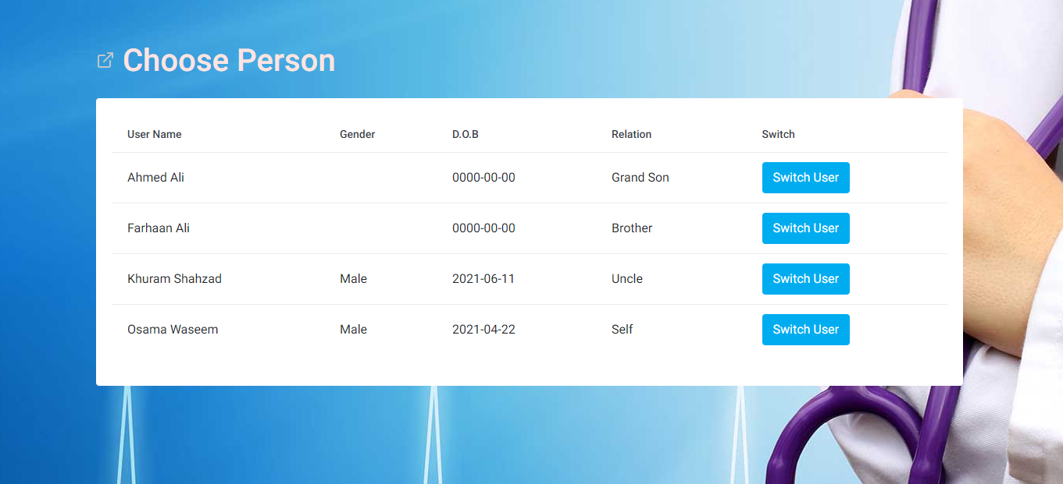
Choose Person

Slide 6
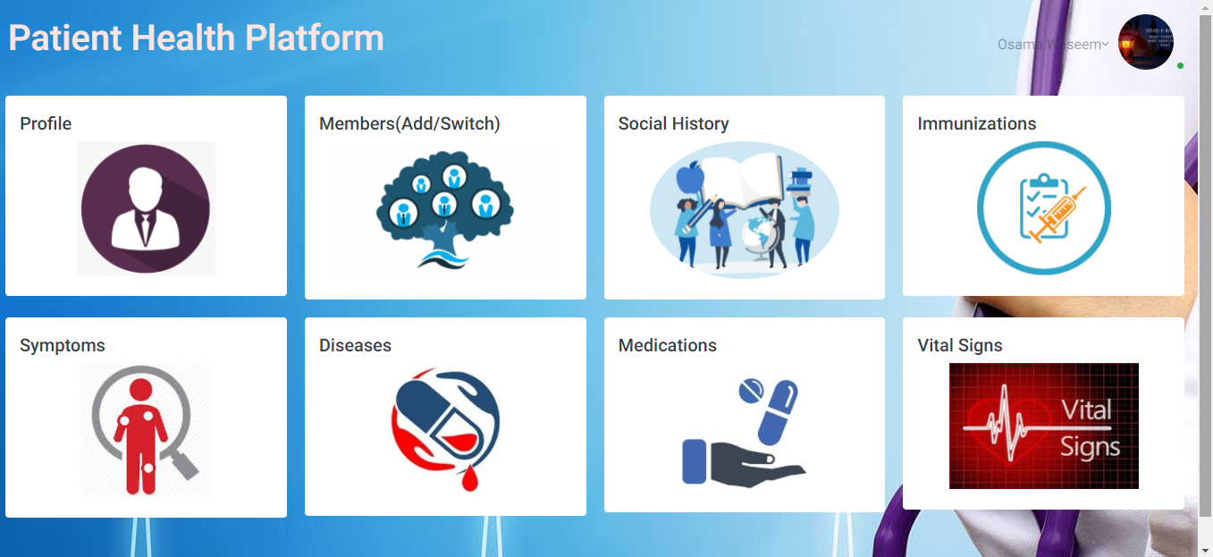
User Dashboard

Slide 7
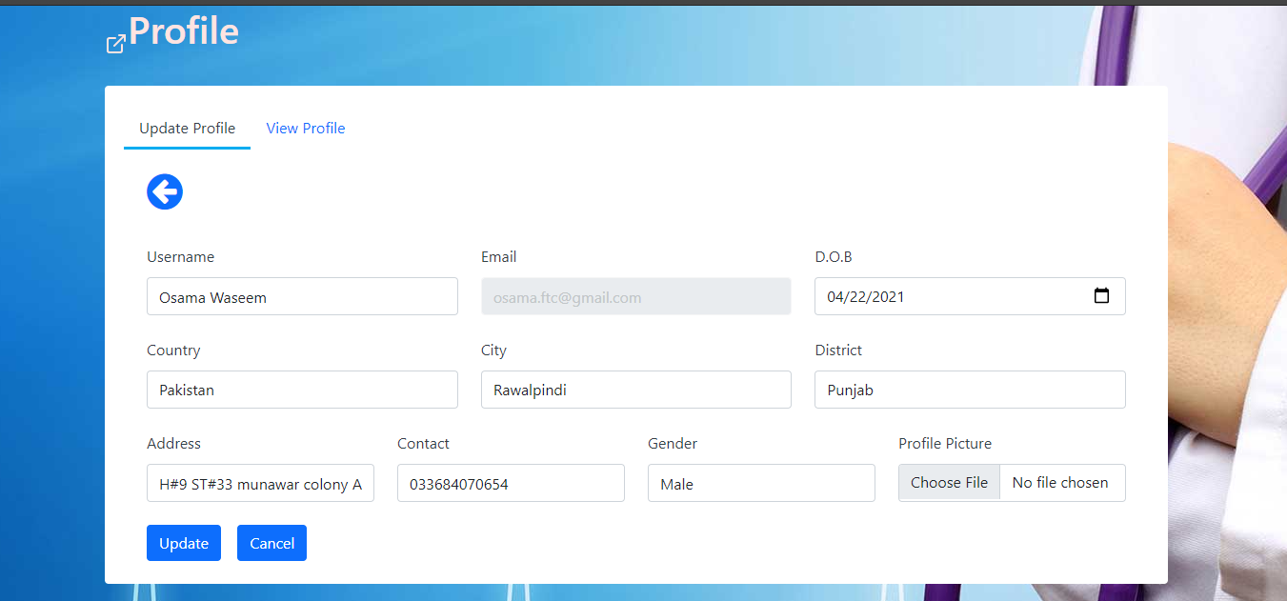
User Profile Update

Slide 8
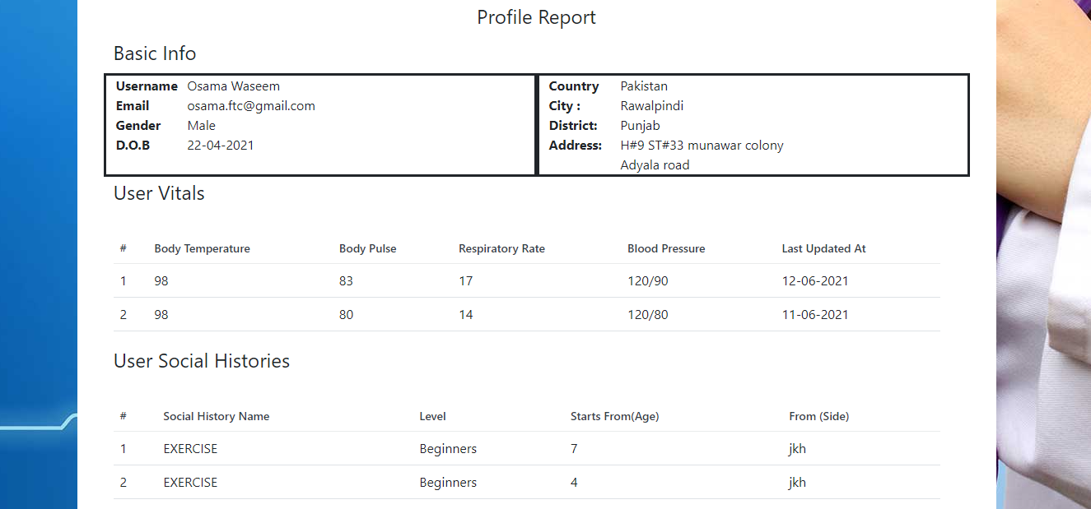
User Profile View

Slide 9
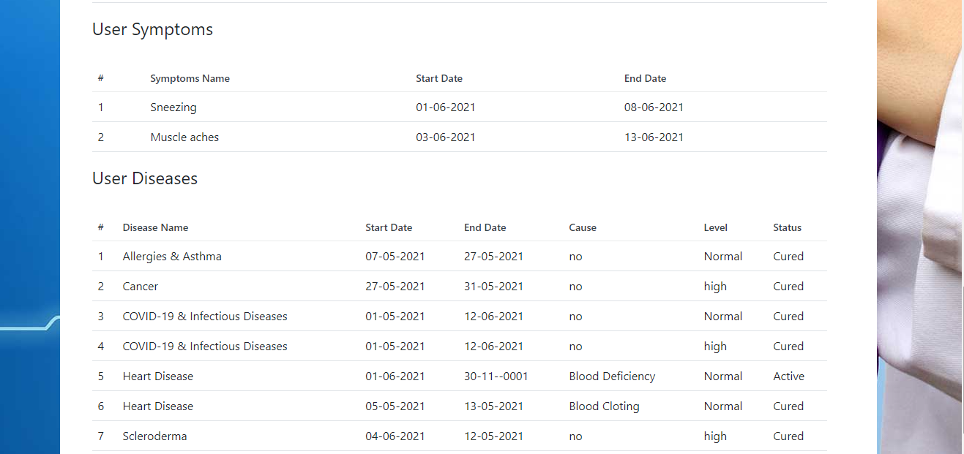
User Profile View

Slide 10
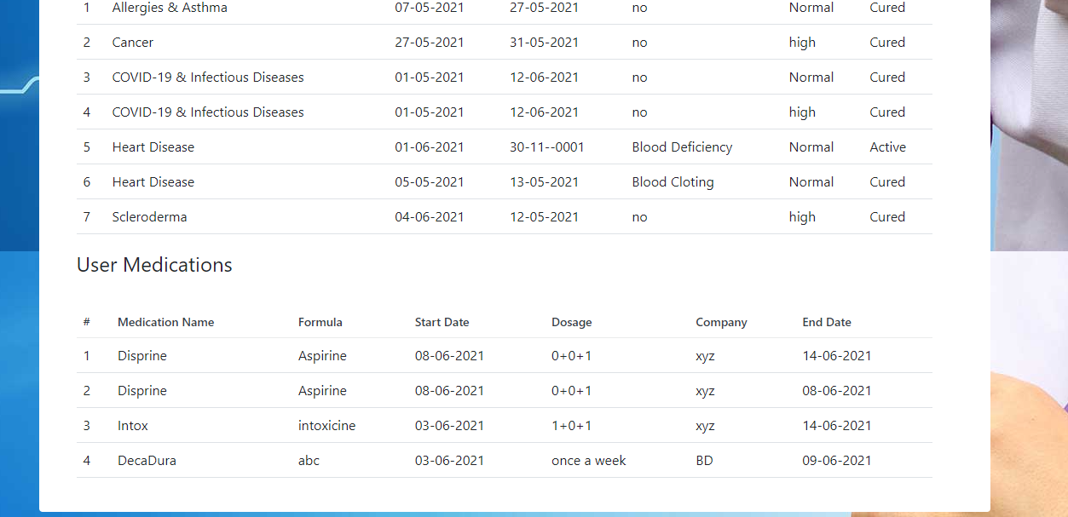
User Profile View

Slide 11
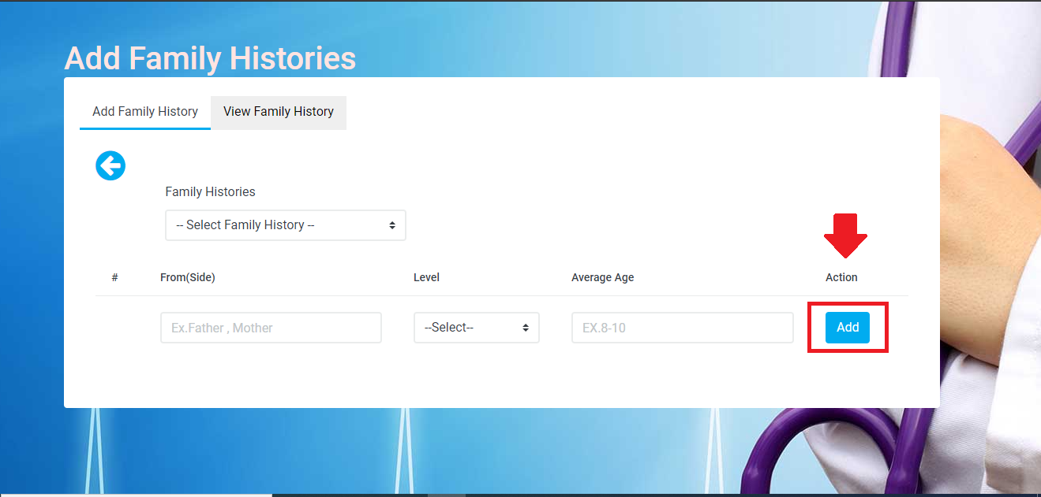
User Family History(Add)

Slide 12
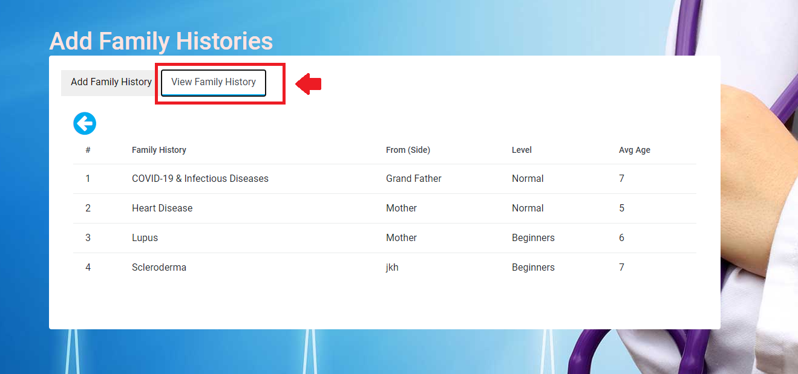
User Family History(View)

Slide 13
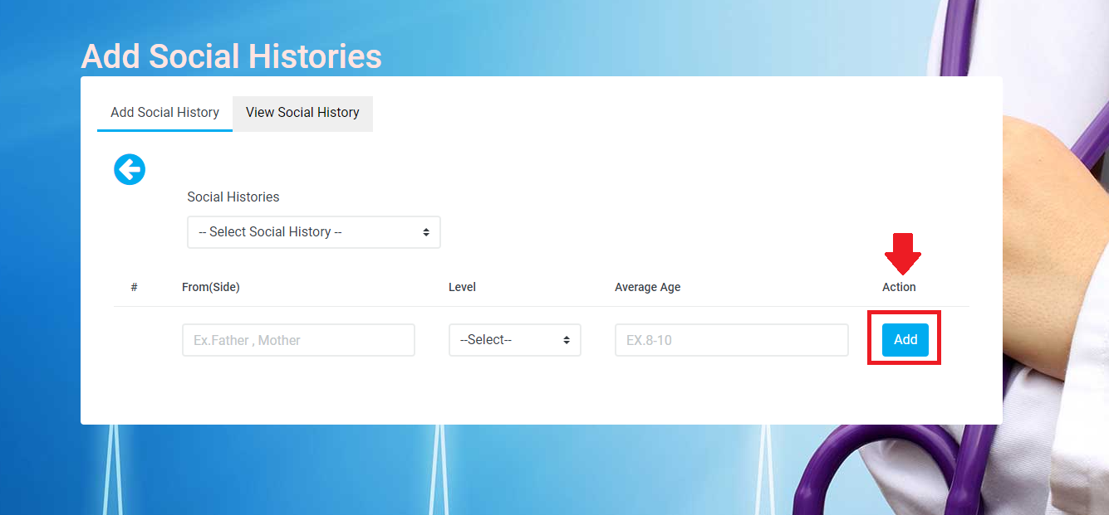
User Social History(Add)

Slide 14
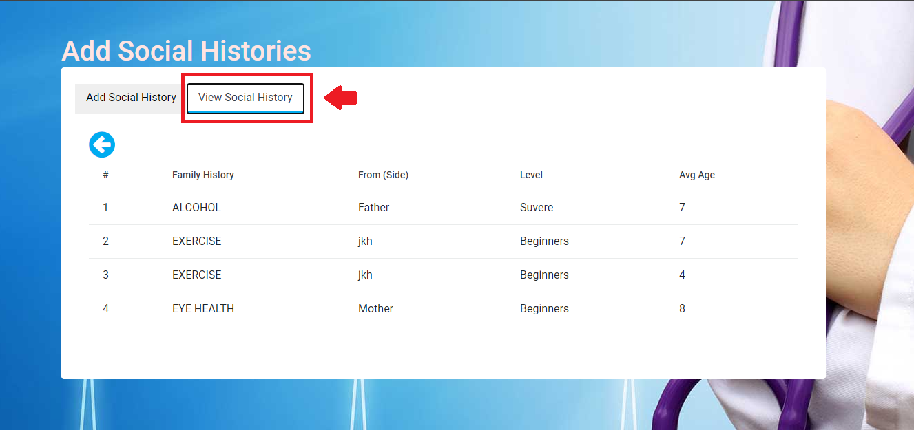
User Social History(View)

Slide 15
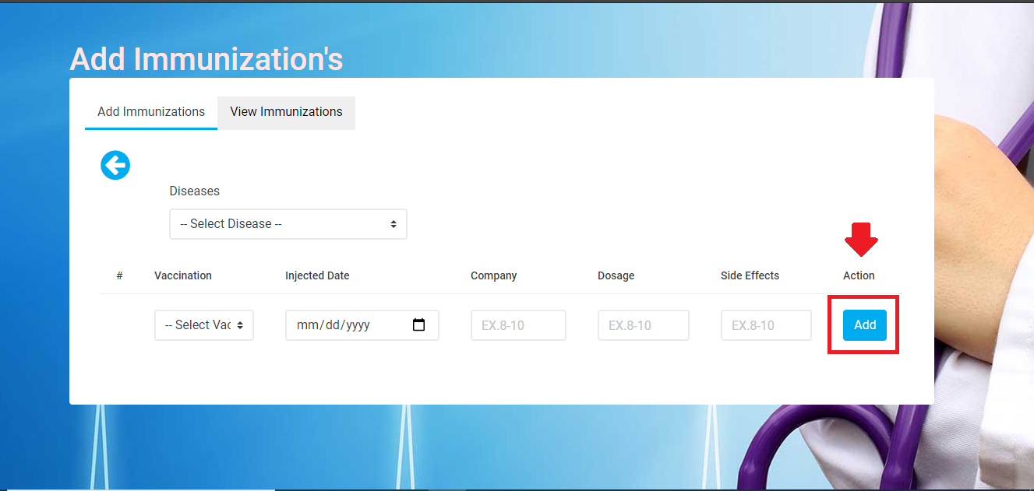
User Immunizations(add)

Slide 16
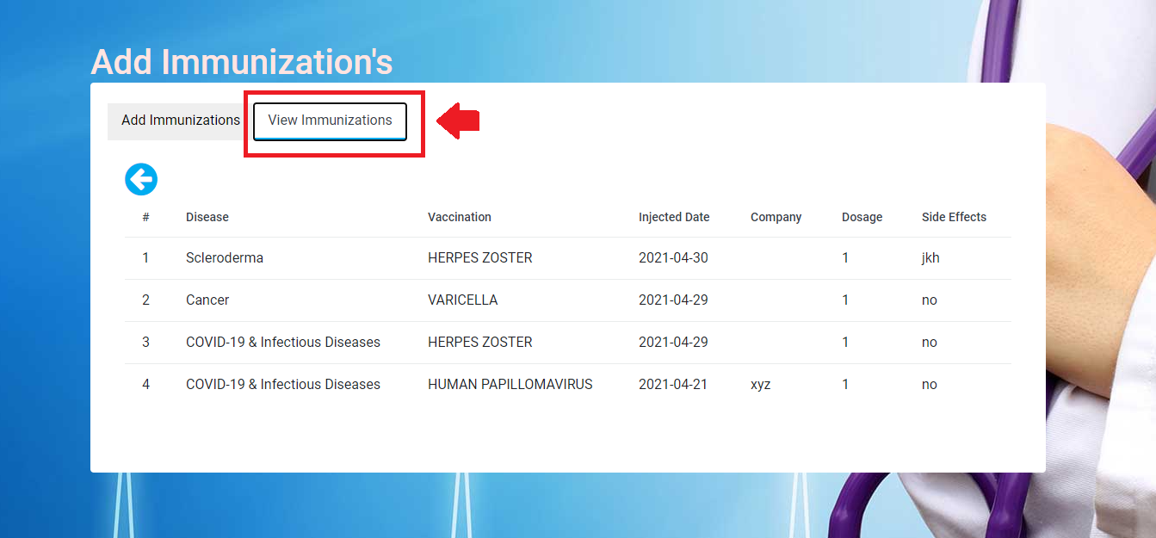
User Immunizations(view)

Slide 17
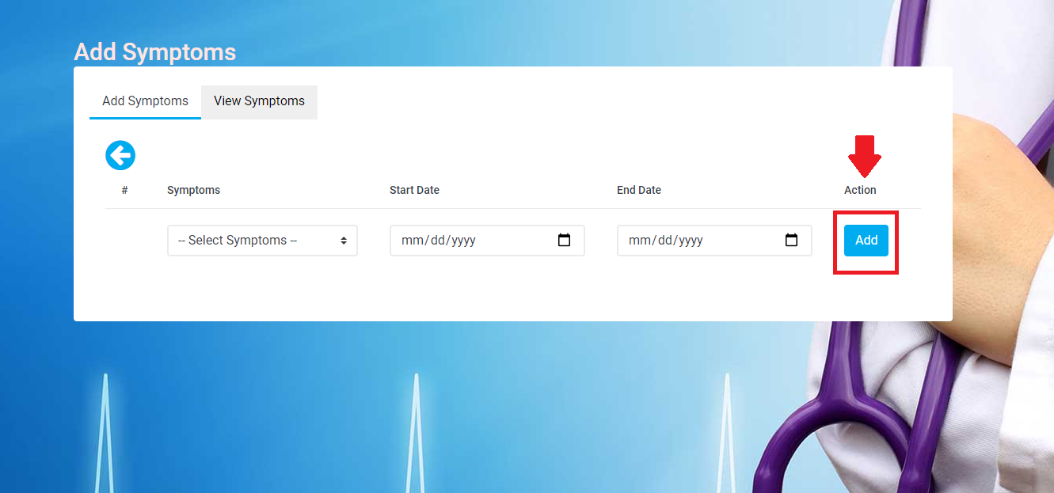
User Symptoms(add)

Slide 18
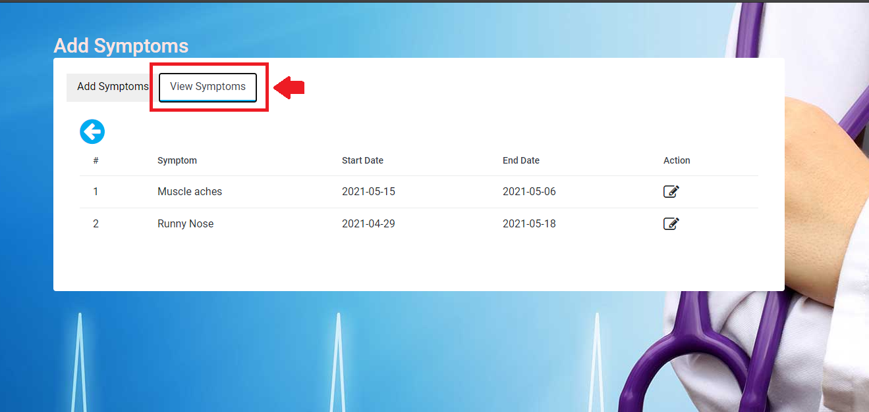
User Symptoms(View)

Slide 19
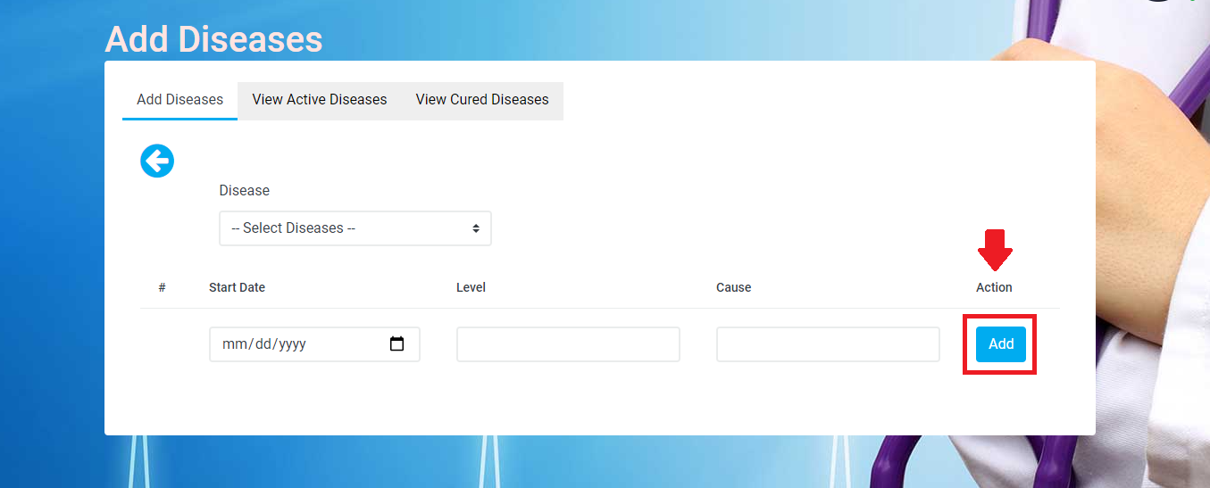
User Diseases (add)

Slide 20
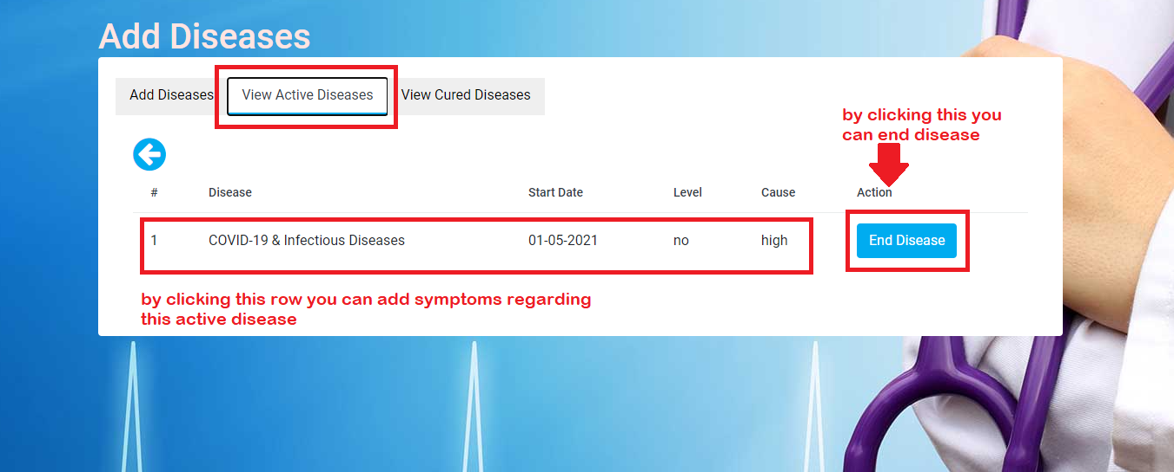
User Diseases (View Active Disease)

Slide 21
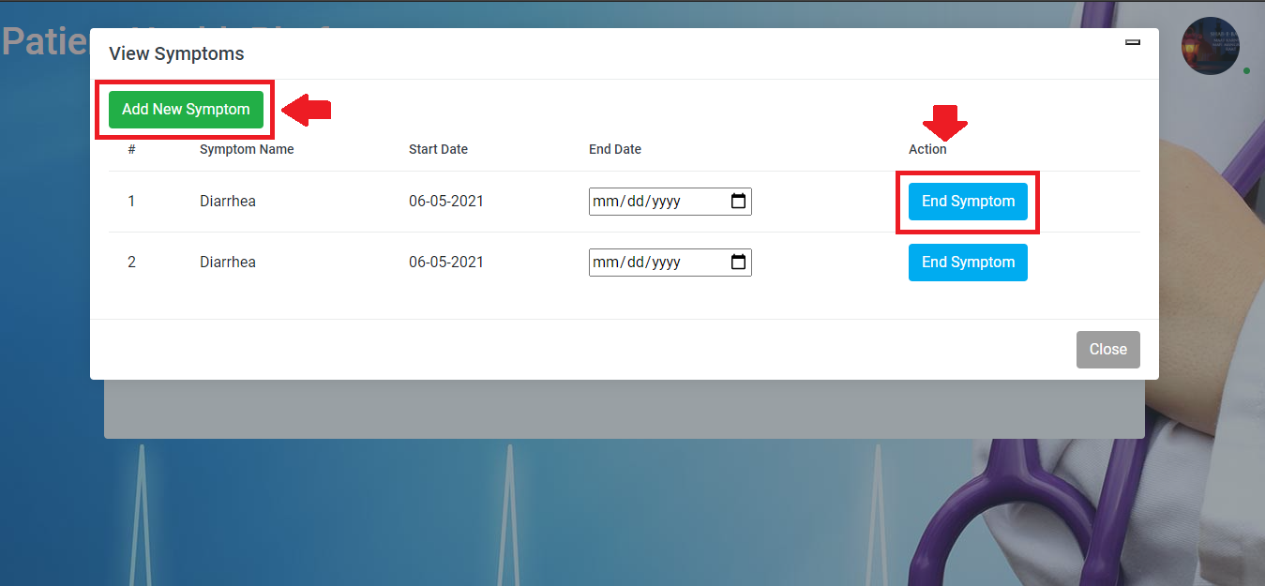
User Diseases (View Active Disease add Symptoms)

Slide 22
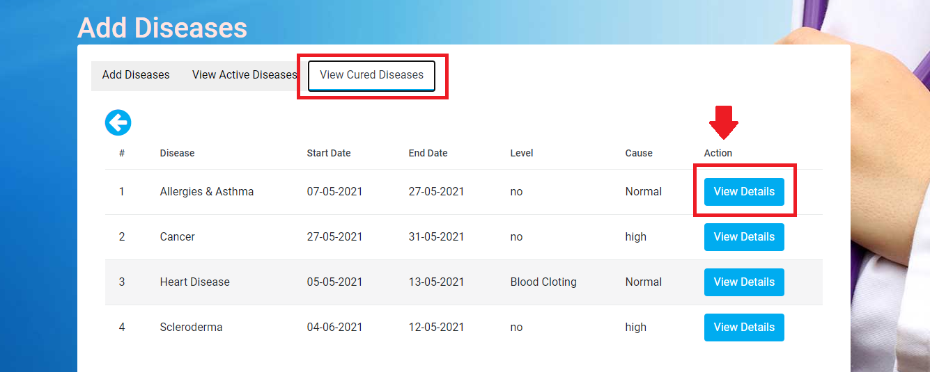
User Diseases (View Cured Disease)

Slide 23
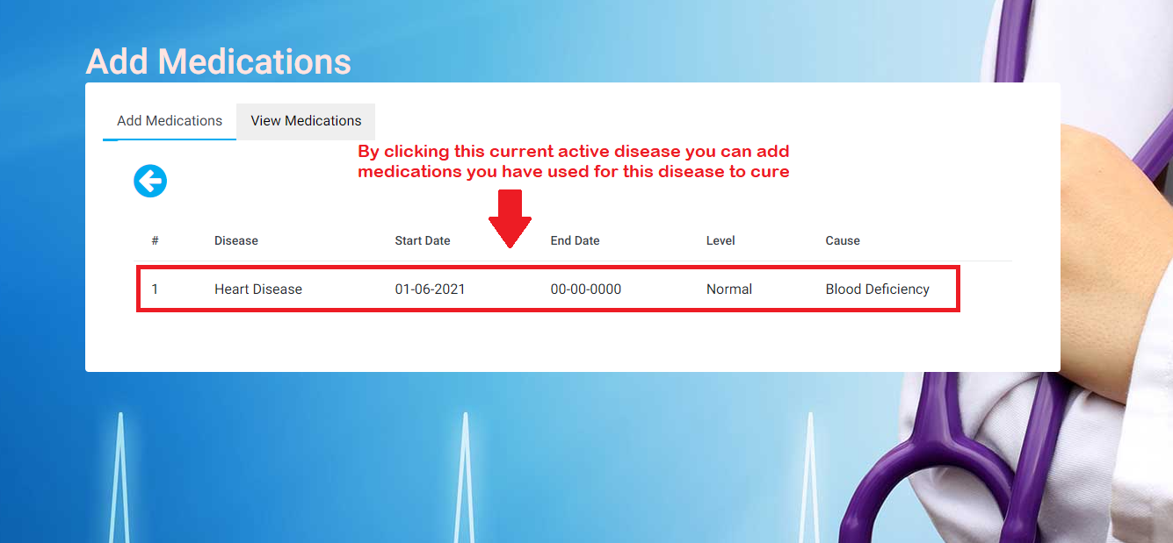
Add Medications

Slide 24
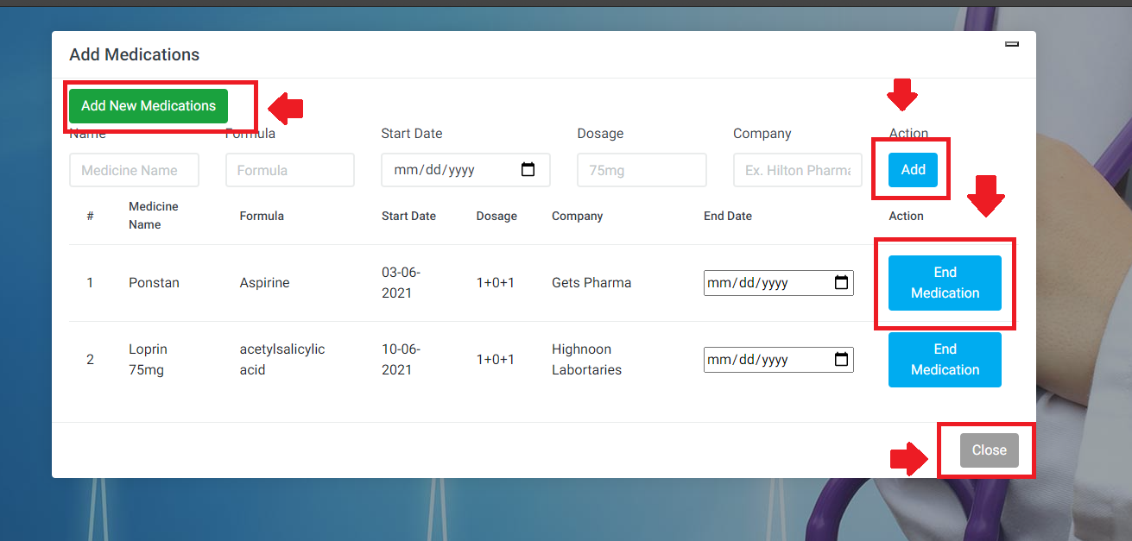
Add Medications

Slide 25
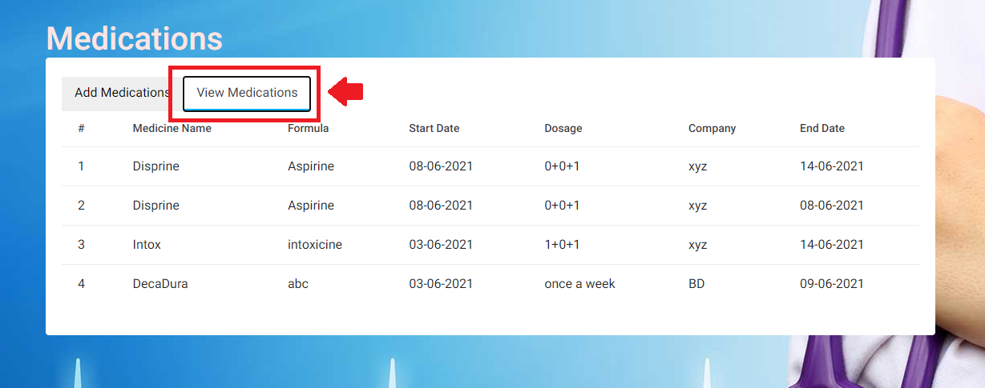
View Medications

Slide 26
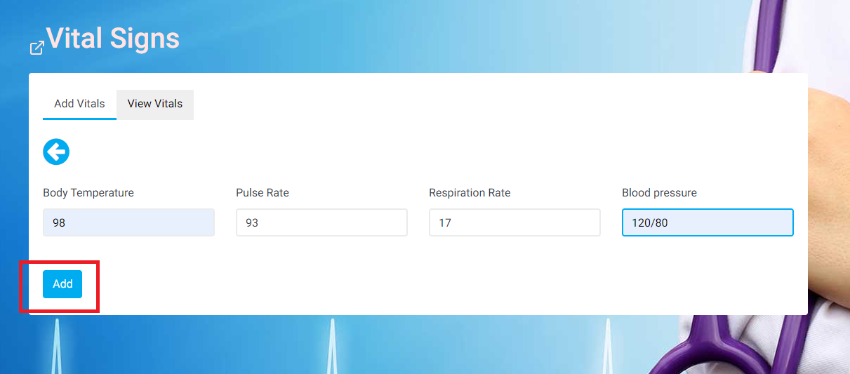
Vital Signs(Add)

Slide 27
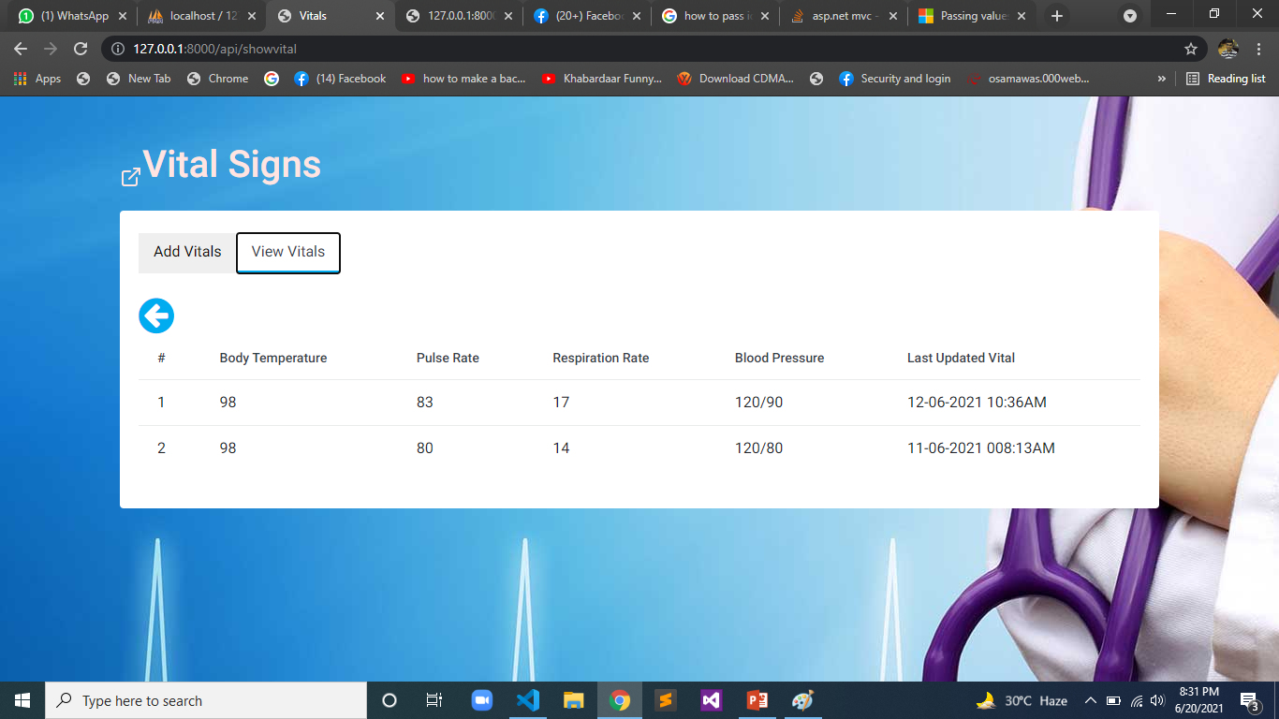
Vital Signs(View)

Slide 28
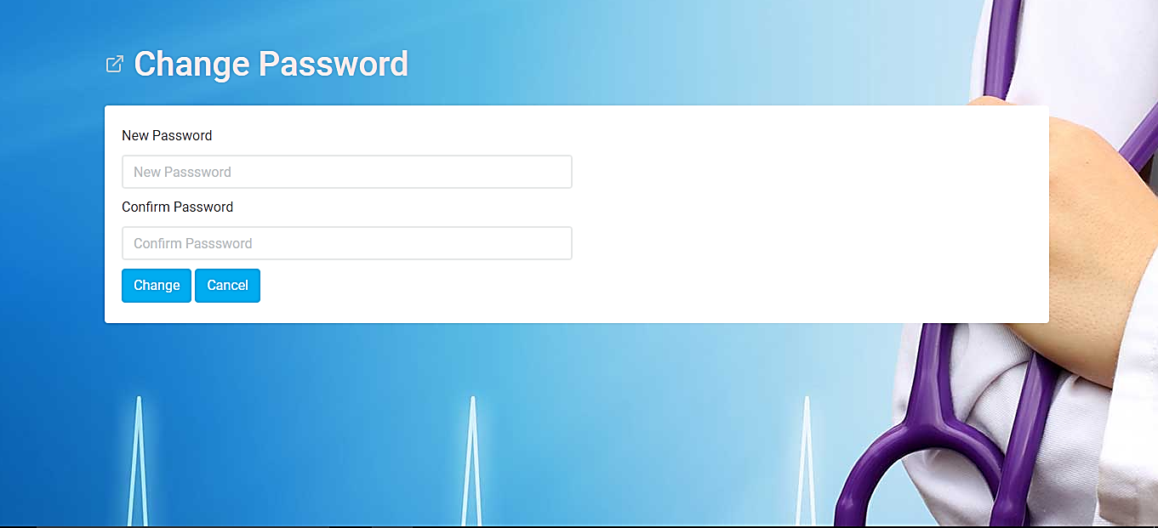
Change Password

Slide 29
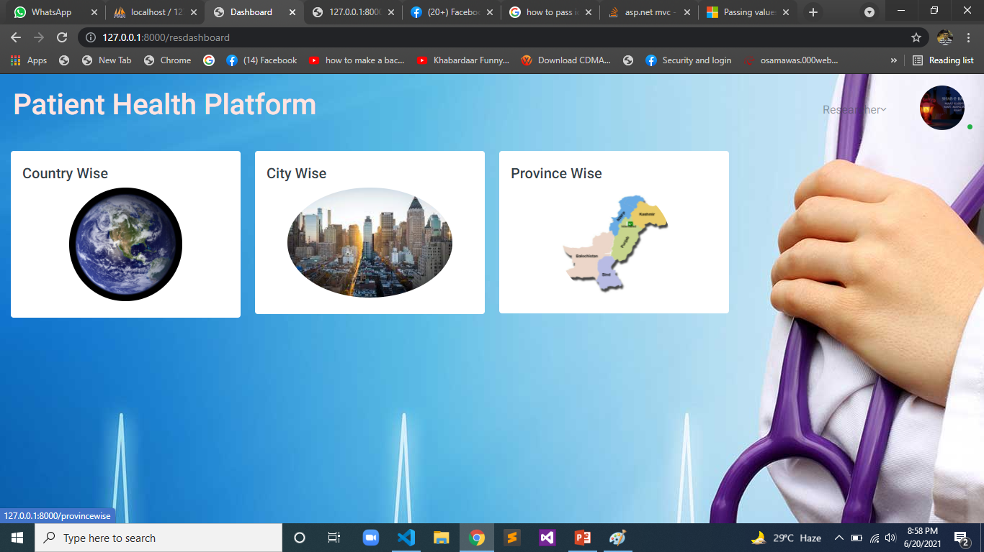
Researcher Side

Slide 30
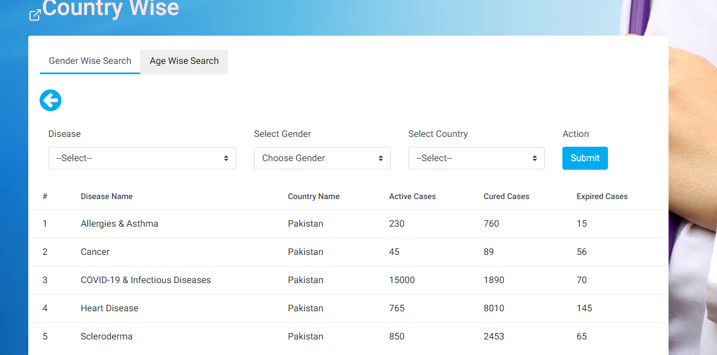
Country Wise Search

Slide 31
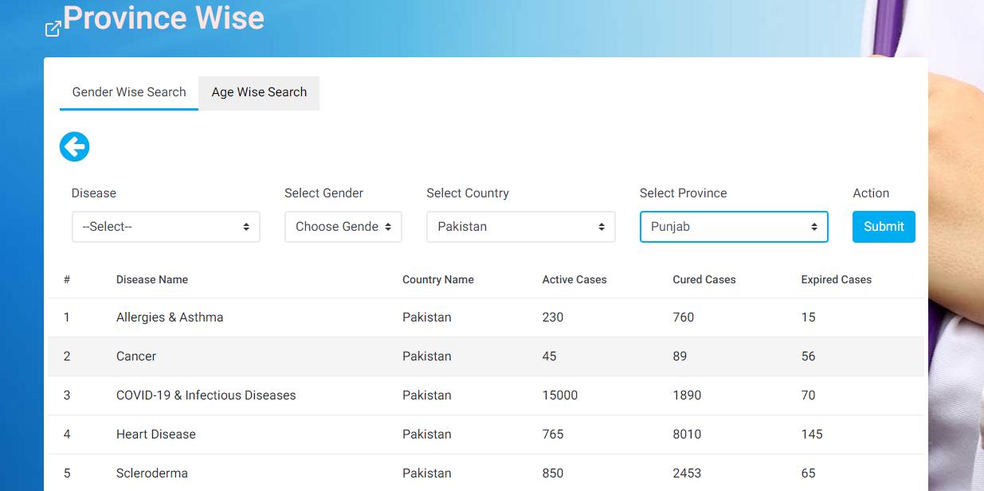
Province Wise Search

Slide 32
IPHONE BASED GUI
Presents By :
Muhammad Usman
CS-8C
Group 3
2017-Arid-3477

Slide 33

Splash Screen

Slide 34
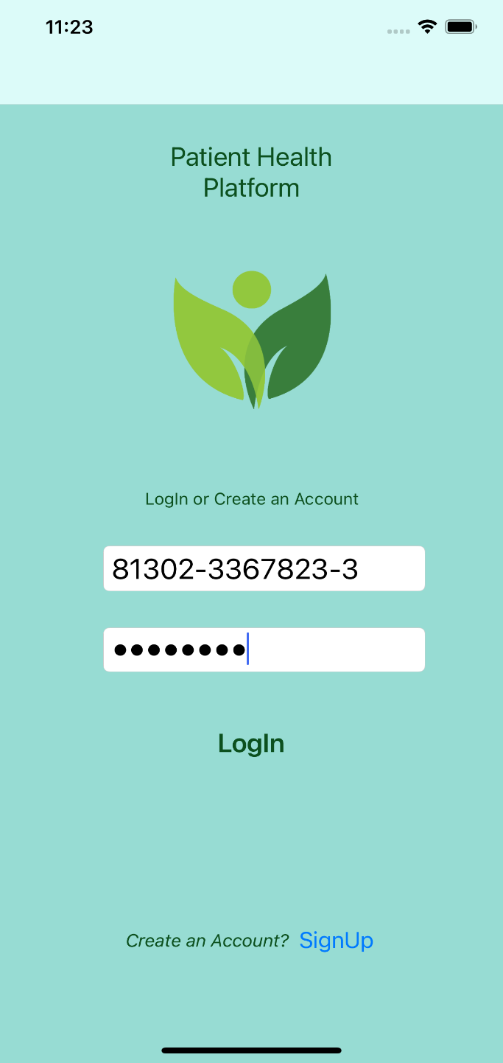
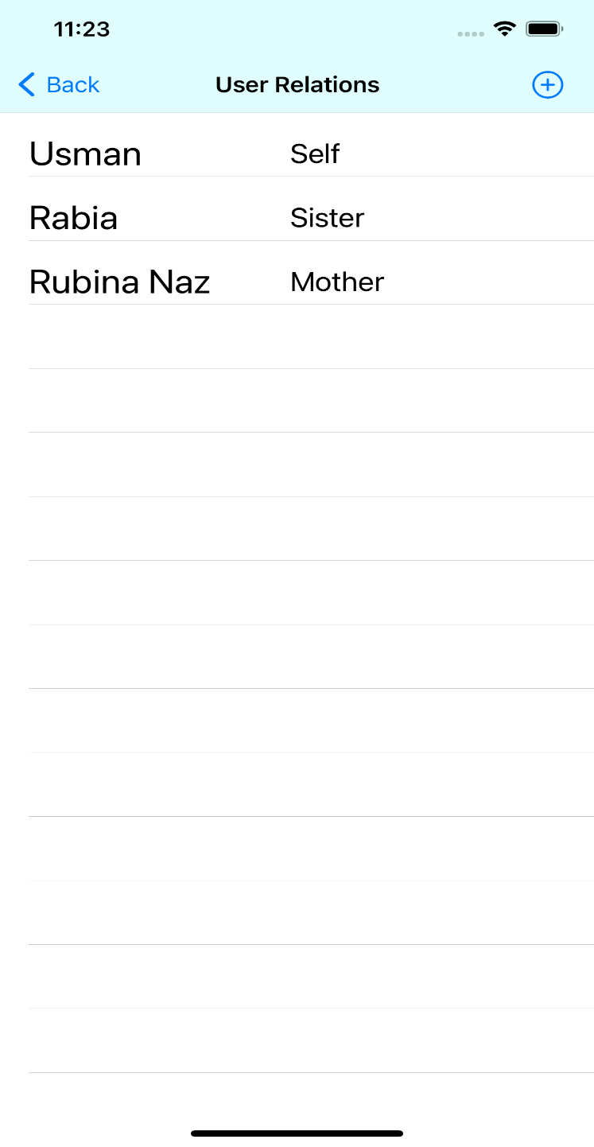
Login And Users List

Slide 35
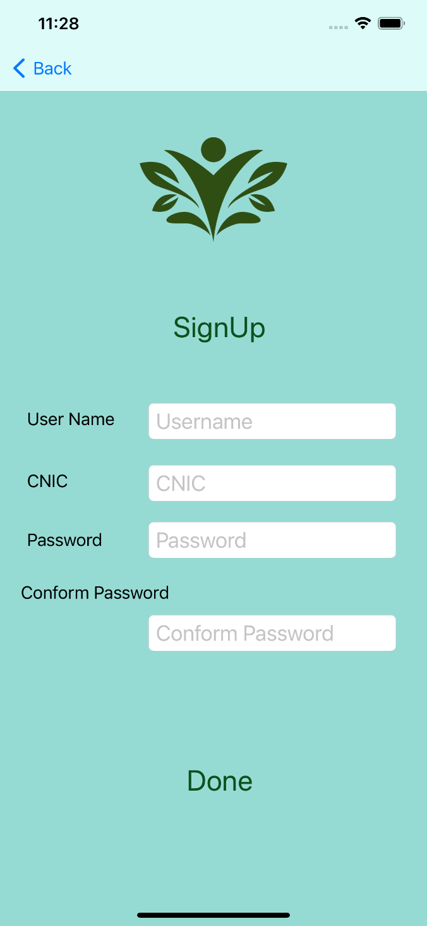
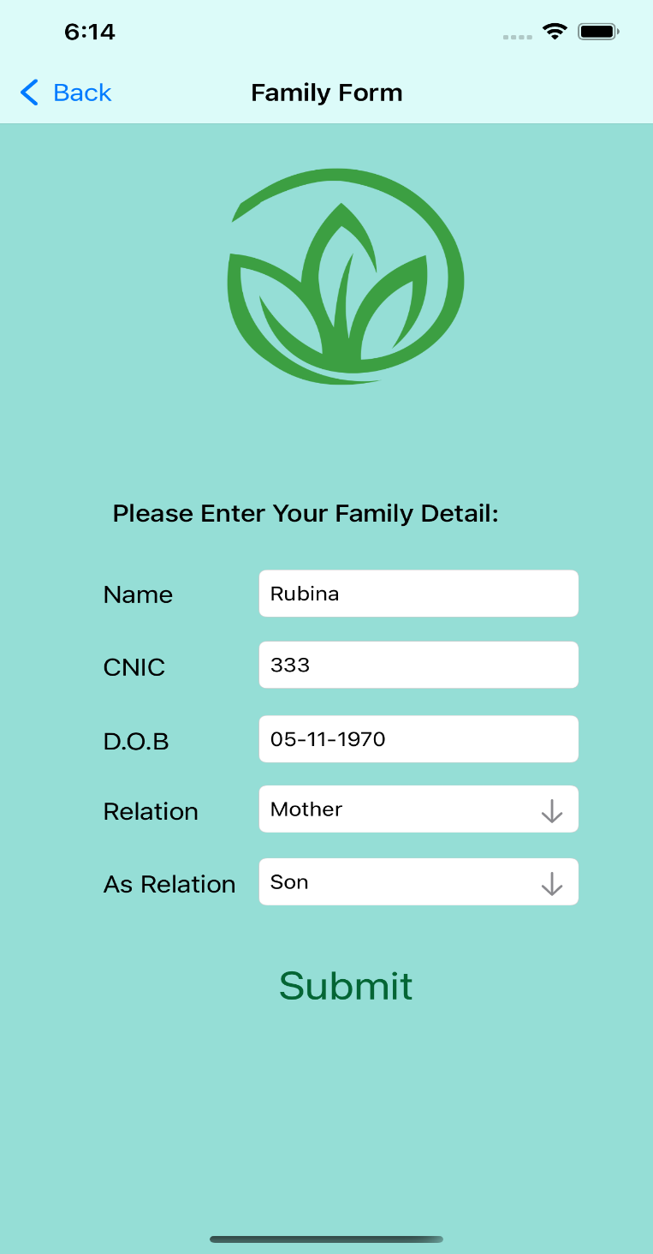
Sign Up And Family Form

Slide 36
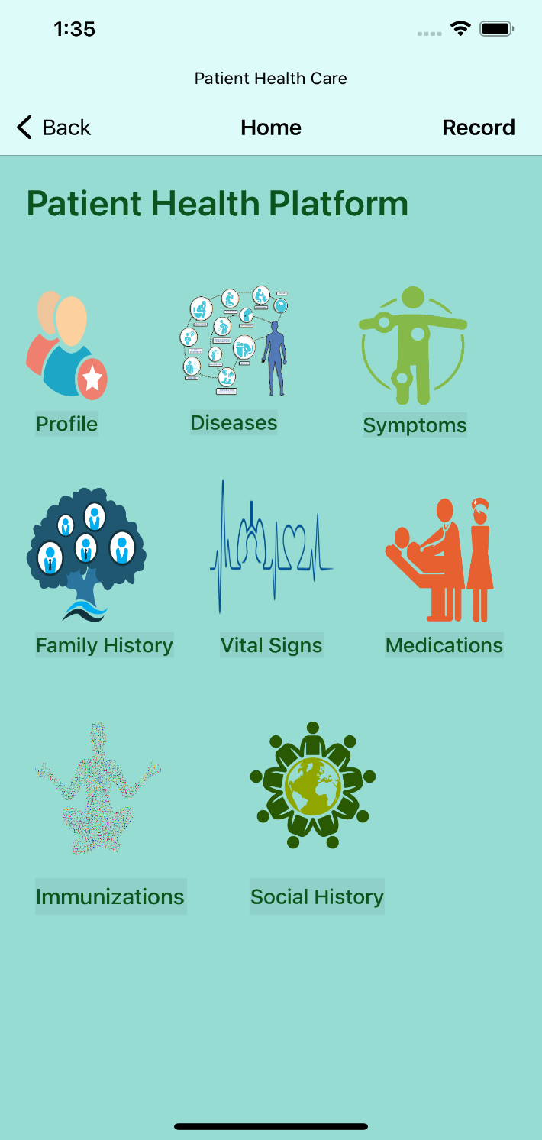
Dashbord

Slide 37
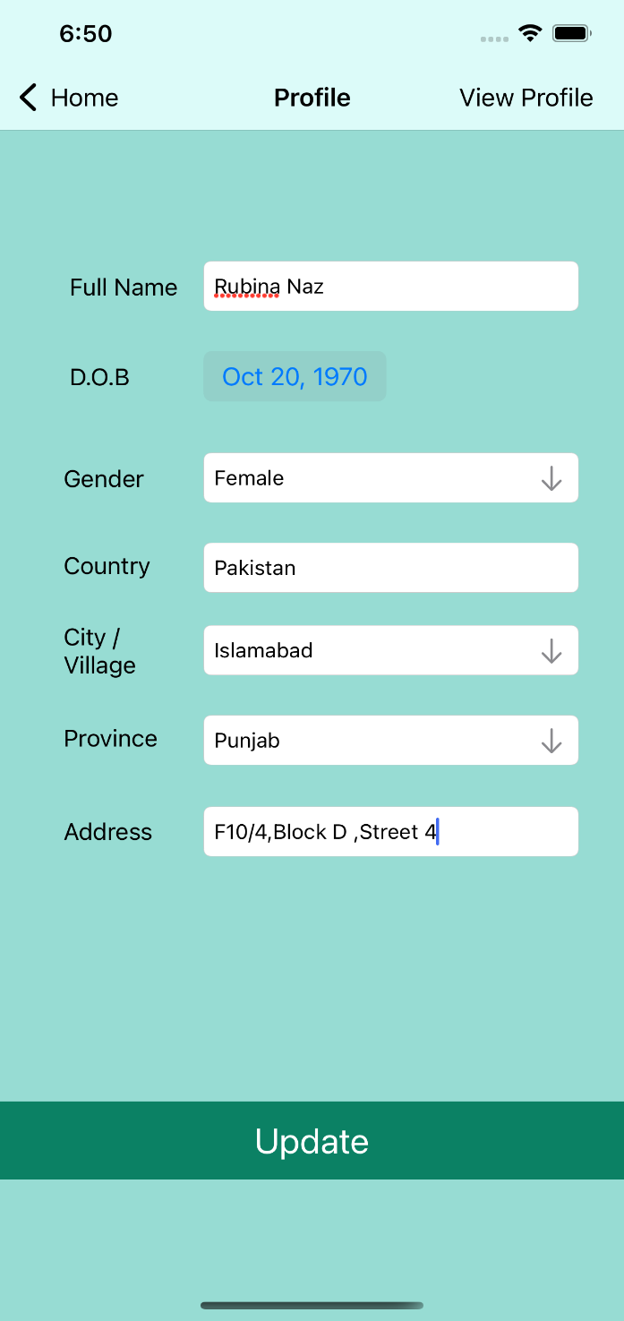
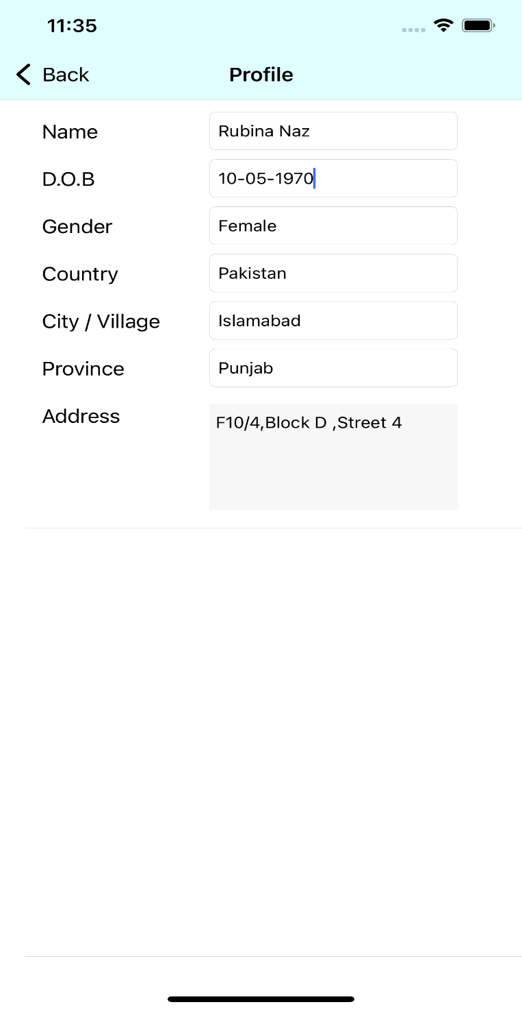
Profile & Show Profile

Slide 38
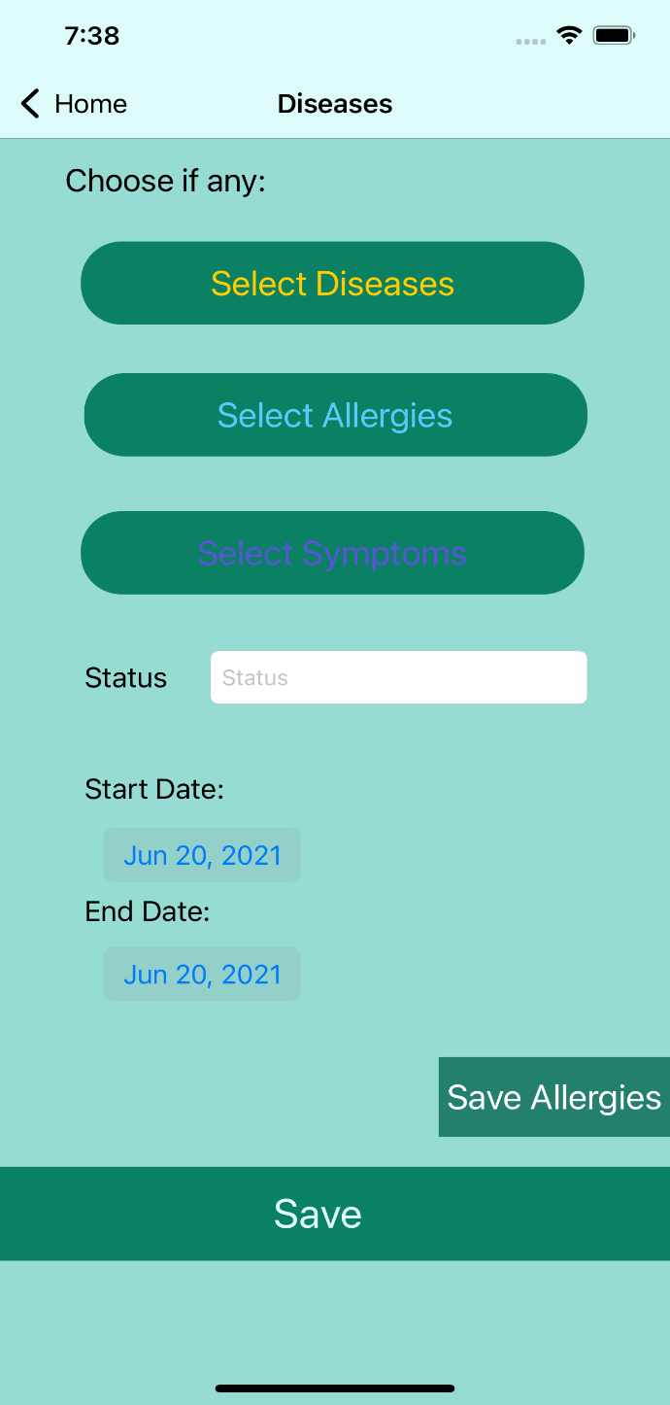
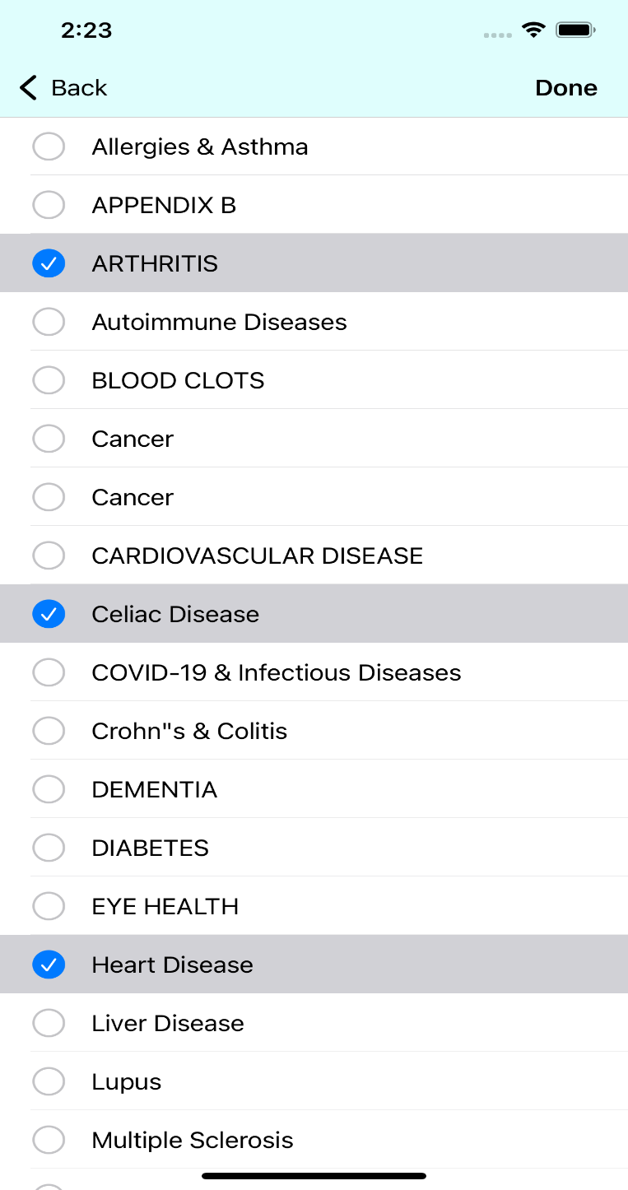
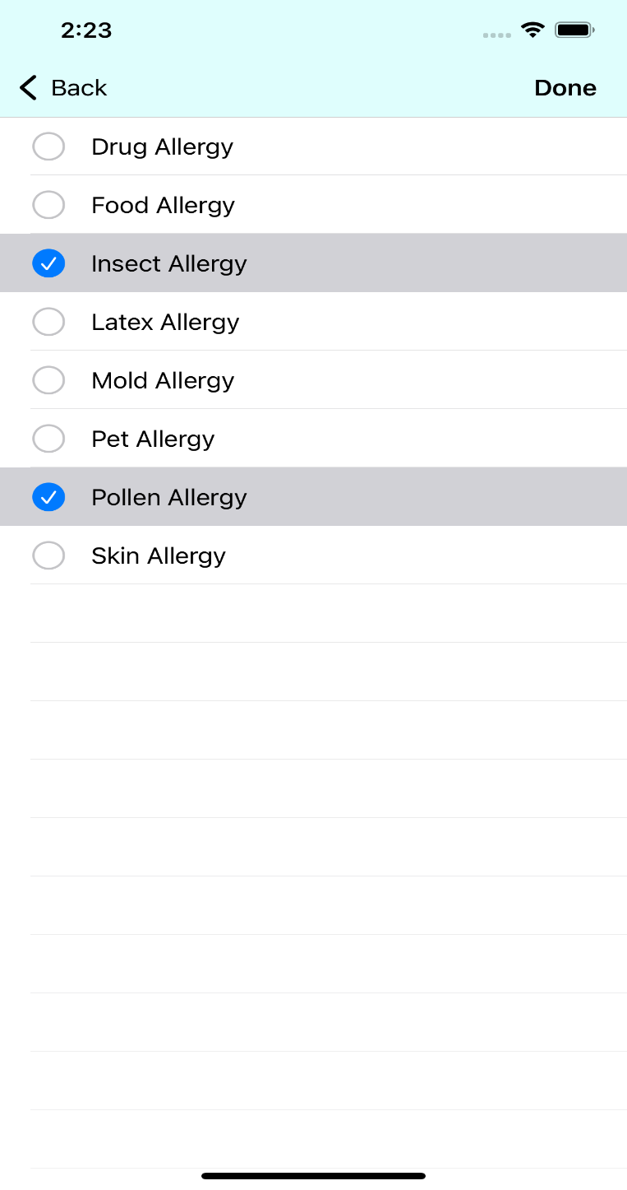
ADD Disease & Allergie

Slide 39
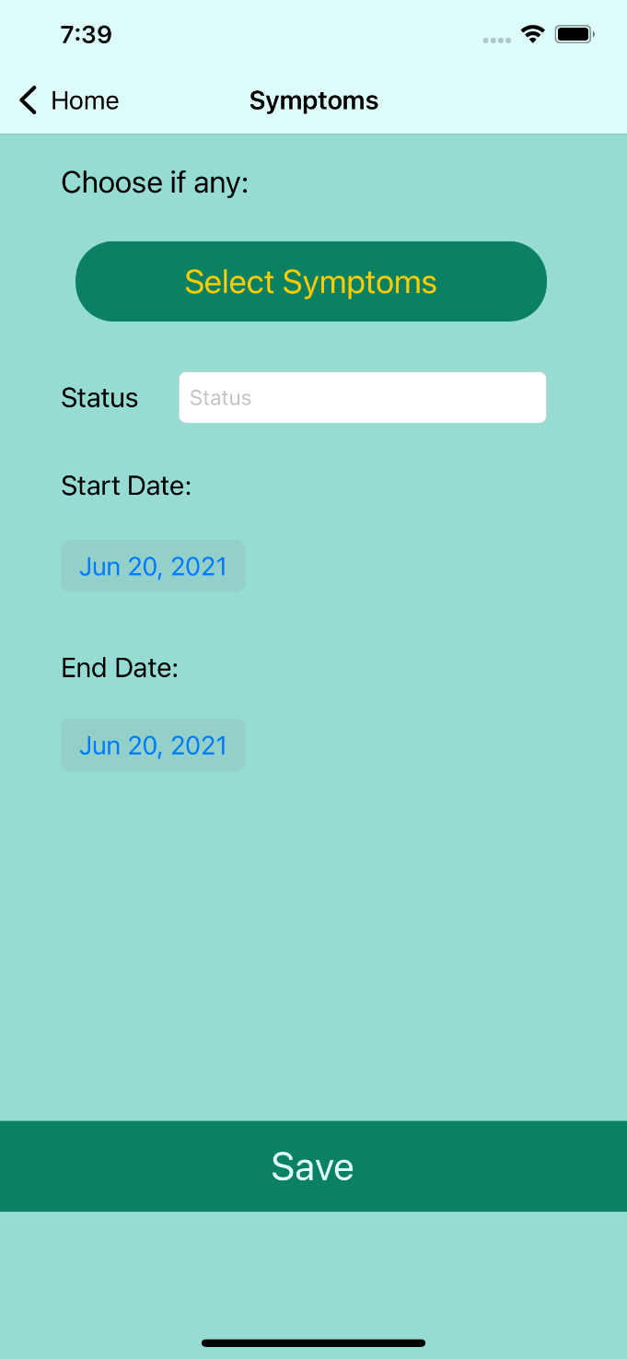
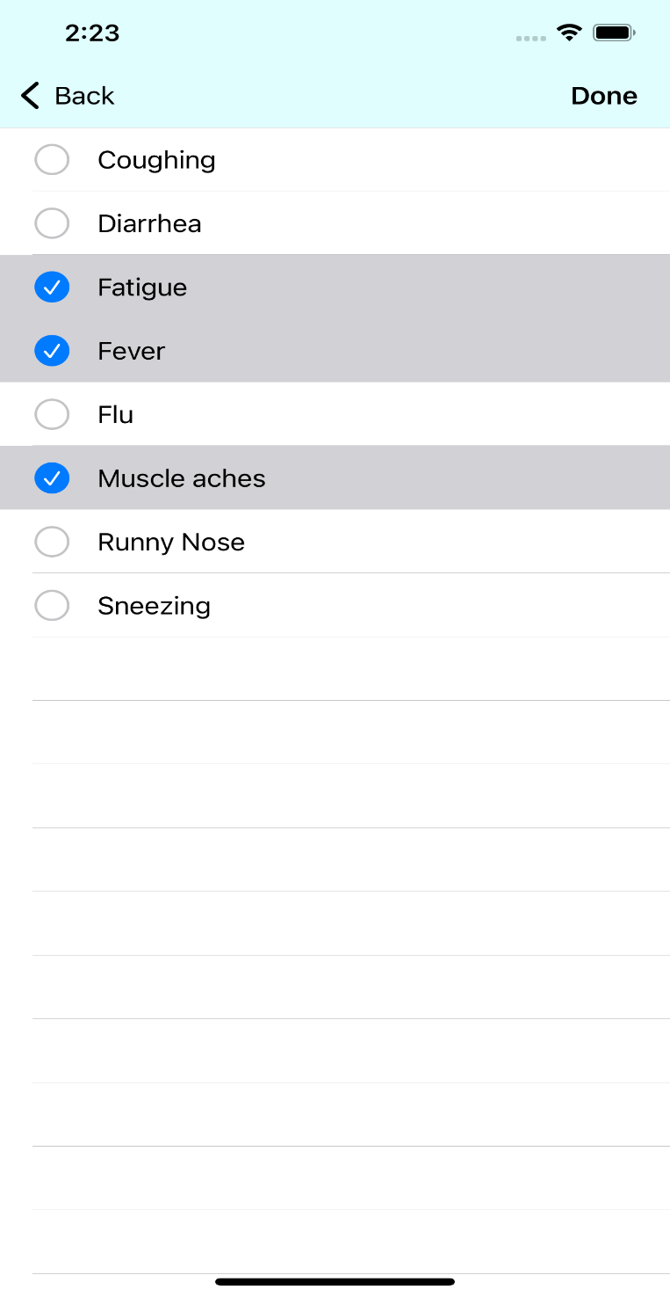
ADD Symptoms

Slide 40
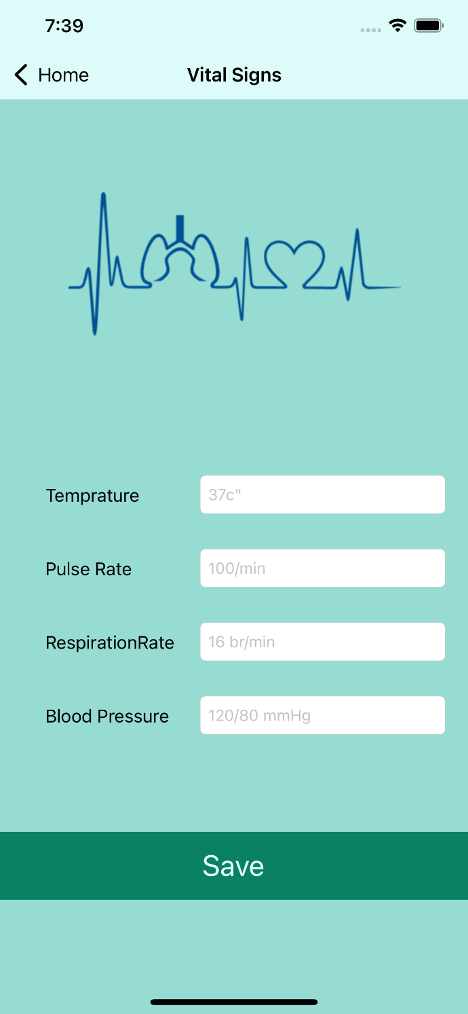
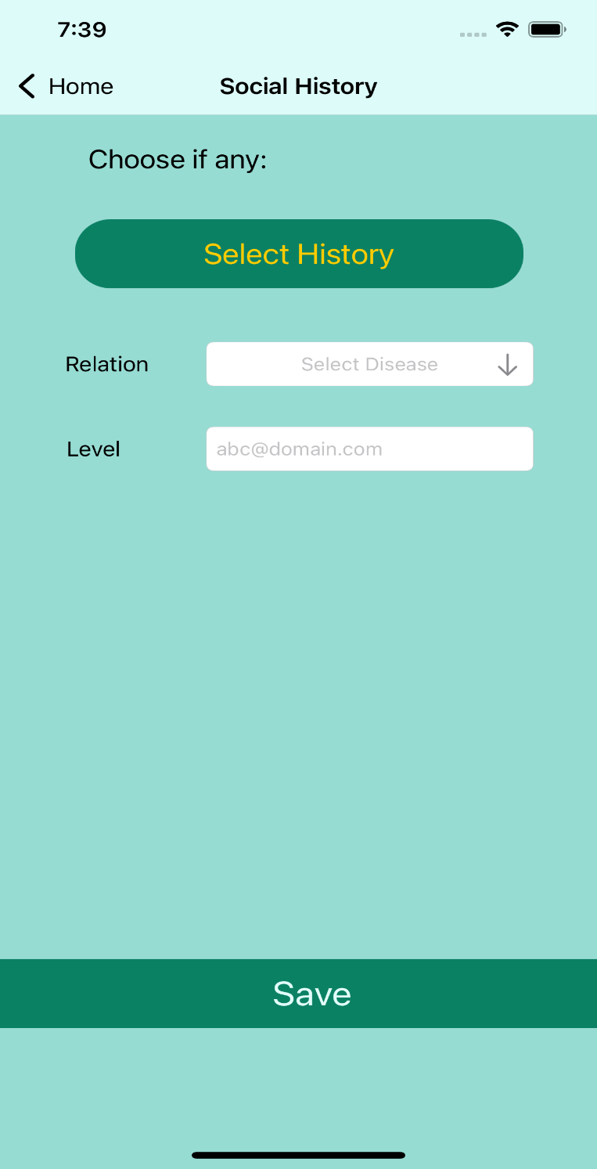
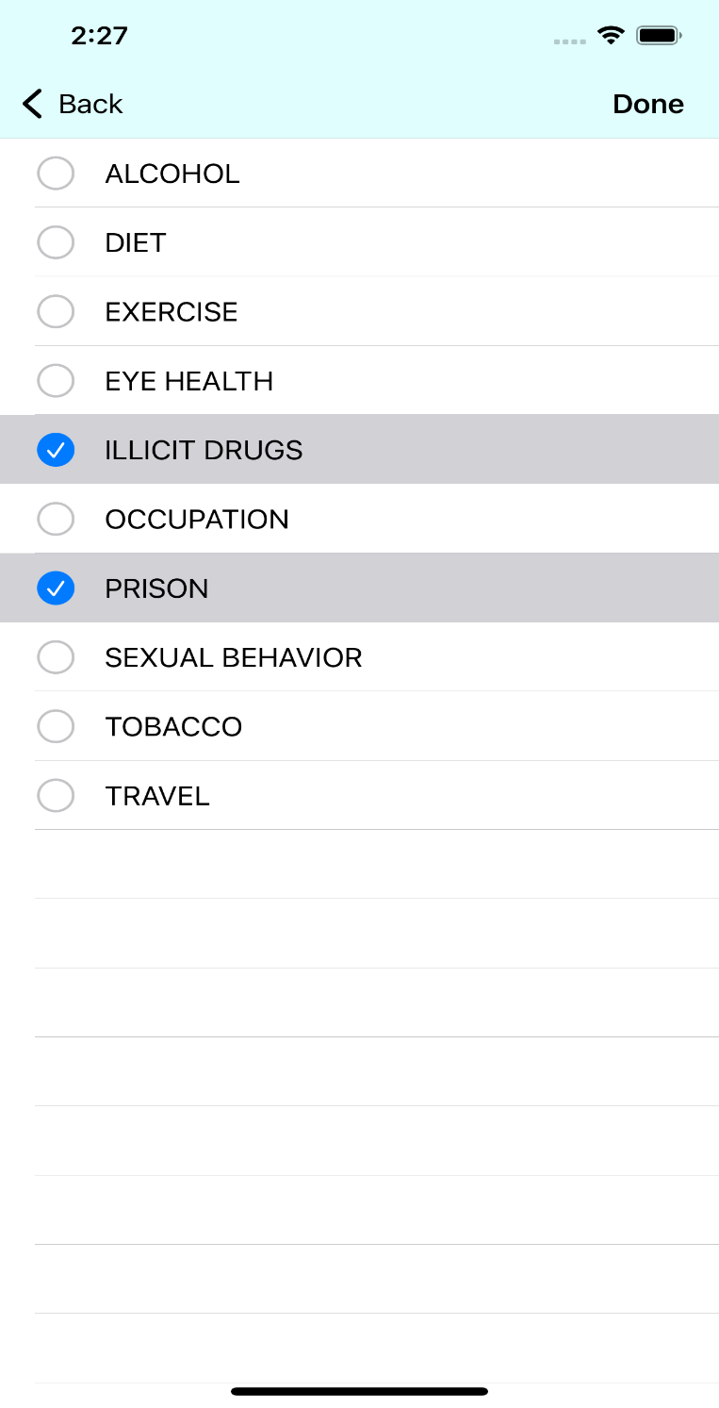
ADD Vitals & Social History

Slide 41
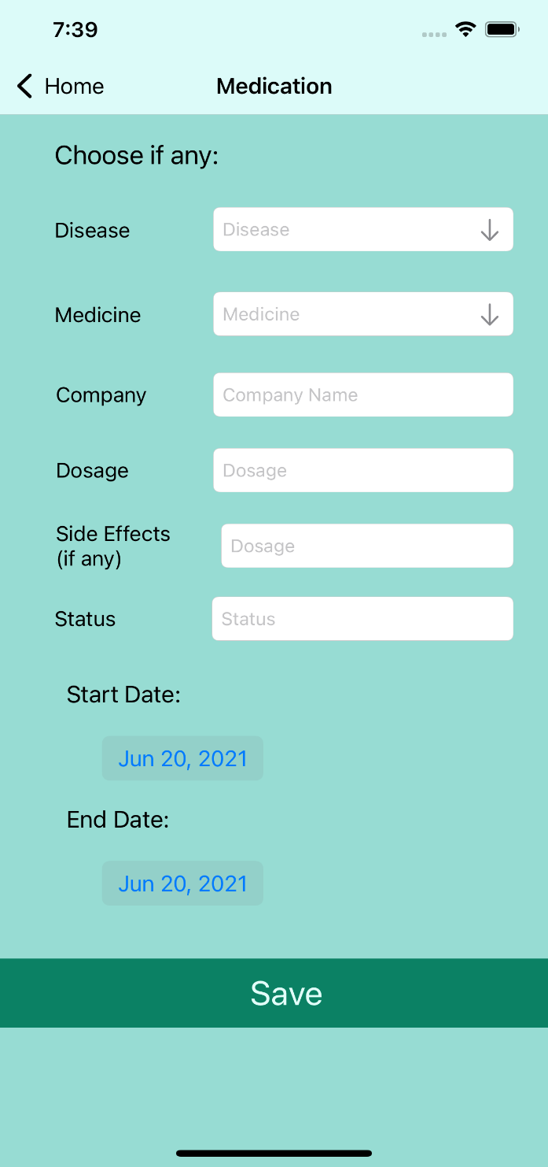
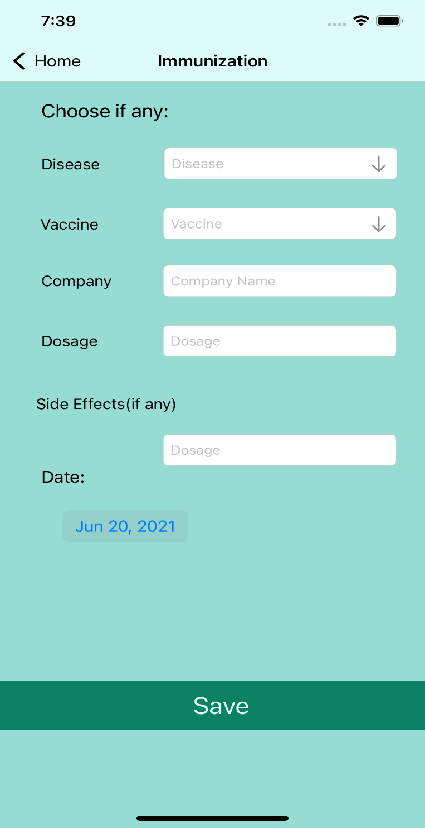
ADD Medication & Immunization

Slide 42
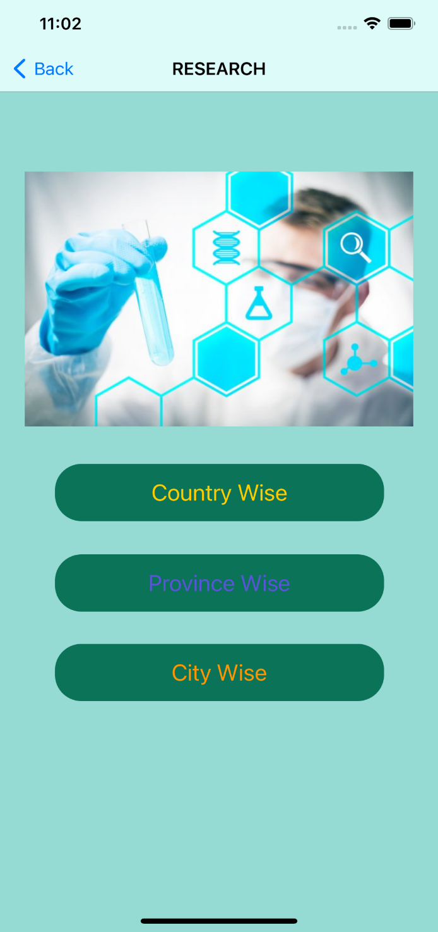
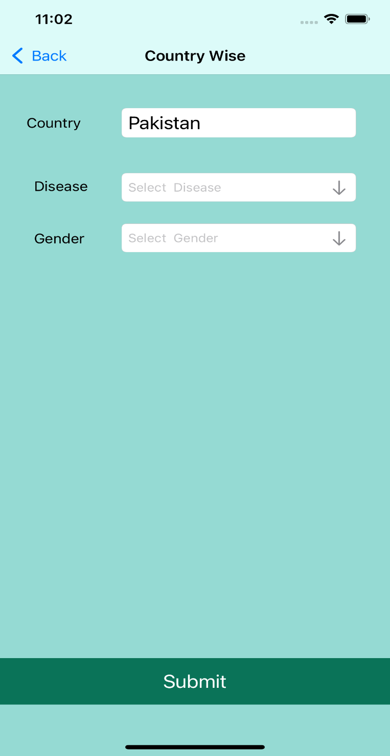
Research Side

Slide 43
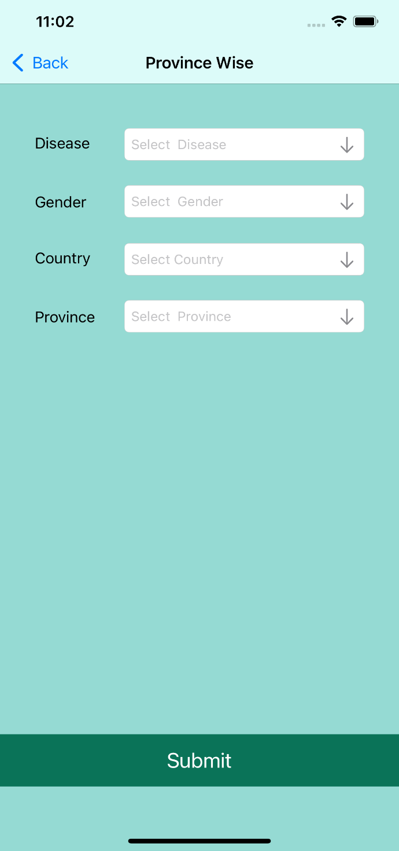
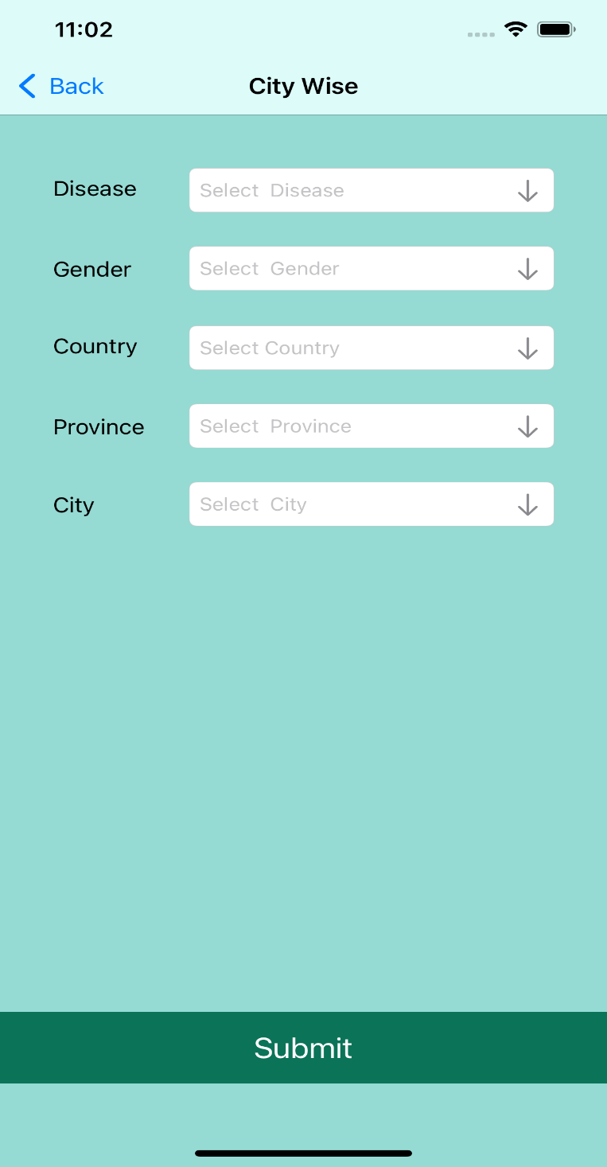
Province Wise & City Wise

Slide 44



User Detail

Slide 45


Show Diseases

Slide 46


Show Vitals & Symptom

Slide 47


Show Medication & Immunization

Slide 48


Show Social History & family History

Slide 49
REACT NATIVE BASED GUI
Presented By :
Muhammad Noman Akhtar
BCS-8A
Group 3
2017-Arid-3465

Slide 50

Splash Screen

Slide 51


Signup & Login

Slide 52


Select Member & Add New

Slide 53



Drawer To Navigate To Add Screens & Main Page To Navigate To Display Screens

Slide 54


Add & Display Disease

Slide 55


Add & Display Family History

Slide 56


Add & Display Social History

Slide 57


Add & Display Immunization History

Slide 58


Add & Display Medication History

Slide 59


Add & Display Symptoms History

Slide 60


Add & Display Vital Signs

Slide 61


Add Personal Info & Display Allergy

Slide 62




Summary

Slide 63


Researcher’s Dashboard

Slide 64




Researcher’s Analysis Screens

Slide 65
Android Based GUI
Presents By :
Usama Qadeer
CS-8B
Group 3
2017-Arid-3549

Slide 66

Splash Screen

Slide 67

Signup Screen

Slide 68

Sign in Screen

Slide 69

Dashboard Screen

Slide 70

Profile Screen

Slide 71

Contact Us Screen

Slide 72


Diseases Screen

Slide 73


Allergies Screen

Slide 74


Medicines Screen

Slide 75


Family Members Screen

Slide 76

Social History Screen

Slide 77


Symptoms Screen

Slide 78


Vital Signs Screen

Slide 79


Immunization Screen

Slide 80


Summary Screen 1

Slide 81


Summary Screen 2

Slide 82


Researcher Analysis Screen

Slide 83
FLUTTER BASED GUI
Presented By :
Maheen Gul
CS-8B
Group 3
2017-Arid-3420

Slide 84


Sign-in
Sign-Up

Slide 85

Member’s Board

Slide 86


User’s Dashboard

Slide 87


User’s Summary

Slide 88

User’s Summary

Slide 89


Disease Entry
Symptoms

Slide 90


Immunization
Medication

Slide 91


Social History
Vitals

Slide 92

Researcher’s Dashboard

